Slide 1
Safety와 Security 의 관계 (사례 기반)
학과
학번
이름
제출 기한: 12월 11일, 월요일 수업 전(3시)까지
*) 늦으면 감점
제출 경로: E-campus
파일 명: HCI_SafetyNSecurity_이름.pptx

Slide 2
과제 설명
Safety와 Security의 뜻을 설명한다.
과거 사례를 찾는다.
사례를 기반으로 Safety와 Security의 관계를 설명한다.
[ 주제 ]
Safety와 Security의 관계에 대한 의견
표지 포함 5장 (내용 4장)

Slide 3
평가 지표 (총 10점)
전체 구성 (3점)
디자인
배치
폰트
색
창의성
정의 (1점)
사례 설명 (3점)
관계 설명 (3점)
다이어그램 이용

Slide 4


Safety 와 Security
Safety
안전성(Safety)은 제품에 문제가 발생했을 때 인명 피해를 최소화(Risk Reduction)하는 것
❑ 사고는 고장 없이도 발생할 수 있음
❑ (기능)안전성은 시스템/부품이 (정상적으로 동작하더라도) 안전을 해치지 않아야 함
Security

Slide 5
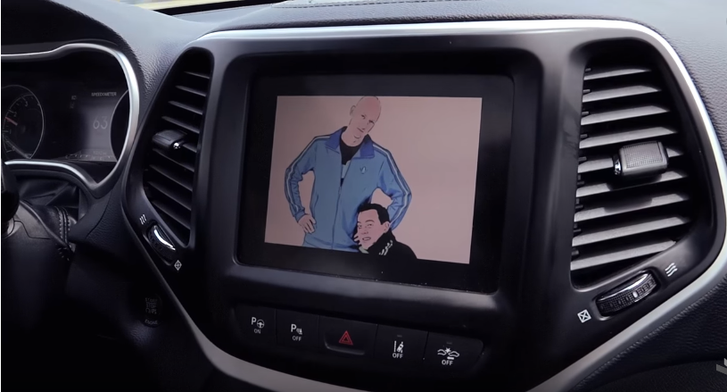
사례
Update: Chrysler recalls 1.4M vehicles after Jeep hack 간추림
The National Highway Safety Administration also plans to look into the issue
Senior Reporter, Computerworld | JUL 24, 2015 11:50 AM PT
Fiat Chrysler Automobiles (FCA), the world's seventh largest automaker, today issued a recall notice for 1.4 million vehicles in order fix
a software hole that allowed hackers to wirelessly break into some vehicles and electronically control vital functions.
Security experts Charlie Miller and Chris Valasek collaborated with Wiredmagazine to demonstrate how they could remotely hack into
-- and control -- the entertainment system and more vital functions of a 2015 Jeep Cherokee. (Video)
"We could have easily done the same thing on one of the hundreds of thousands of vulnerable vehicles on the road," Miller told Computerworld
The hackers were able to use the cellular connection to the Jeep's entertainment system, or head unit, to gain access to other systems;
the head unit is commonly connected to various electronic control units (ECUs) located throughout a modern vehicle. There can be as many as
200 ECUs in a vehicle.
Miller and Valasek shared their cyber security work with Chrysler, which this week issued a software patch to fix the hole.
But drivers were left to their own devices to install the patch, which would typically be done by downloading the patch to a USB drive;
the USB drive is then plugged into a vehicle port and uploaded.
In explaining the voluntary recall, FCA said it plans to update U.S. vehicles equipped with 2013-2015 UConnect head unit systems.
"Further, FCA US has applied network-level security measures to prevent the type of remote manipulation demonstrated in a recent media report” the company said in a statement. "These measures - which required no customer or dealer actions - block remote access to certain vehicle
systems and were fully tested and implemented within the cellular network on July 23, 2015."
Chrysler customers affected by the recall will receive a USB device that they may use to upgrade vehicle software,
which provides additional security features independent of the network-level measures.
Vehicle owners can also visit the FCA's software update website to determine if their vehicle is included in the recall.
Owners will need to input their Vehicle Identification Number (VINs).
While Chrysler may fix this particular security flaw, others in its software could likely be exploited, Miller said.

Slide 6
사례 설명
2015년에 자동차회사 크라이슬러가 해킹을 통해 원격으로 자동차를 제어할 수 있는 것이 밝혀져 판매된 자동차를 리콜, 업데이트하는 사건이 있었다.
요즘의 자동차들은 내부적 소프트웨어로 모든 기능들이 연결되어 있기 때문에 해킹을 통해 라디오, AC, 심지어는 핸들과 엑셀, 브레이크 까지 제어하는 권한도 가질 수 있게 된다는 것이다.
해킹을 통해 Security가 무너지게 되면 운전자 및 동승자의 Safety가 위협받게 되는 것이다.

Slide 7
Safety
Security
Problem

